Slide 1
EE464 Feedback Session
Mert Eren Kandilli
Emre Çakmakyurdu
Kubilay Kaya

Slide 2
Overview
Topology Selection
Magnetic Design
Core Selection
Cable Selection
Winding
Component Selection
MOSFET Selection
Diode Selection
Output Capacitor Selection
Controller Design
IC Selection
Design
Efficiencies

Slide 3
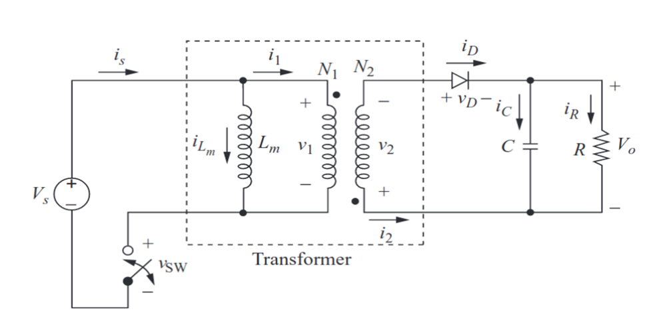
Topology Selection
Flyback Converter

Slide 4
ADVANTAGES
● Design is simple compared to other DC-DC topologies
● Switching element count is less.
● It can operate in a wide range of input voltages.
● Cost is less than other DC-DC topologies.
DISADVANTAGES
● Ripple at the output current is higher.
● Core is gapped so EMI problems can occur.
● Losses are increased.
● Requires additional snubber circuit to discharge the leakage inductance in the transformer.

Slide 5
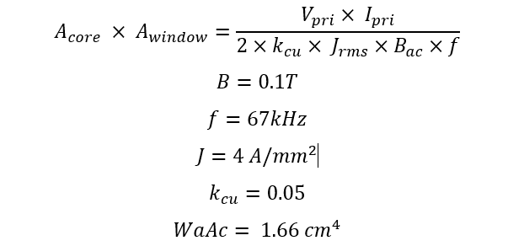
Magnetic Design

Slide 6

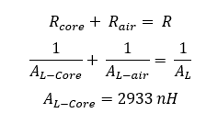
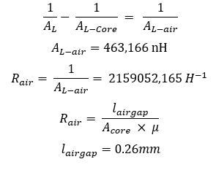

Slide 7
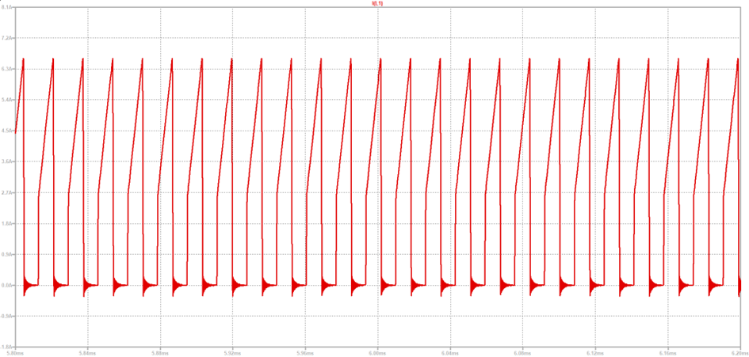
Figure : Primary Side Current Waveform
Primary Current RMS Value : 3.3A

Slide 8
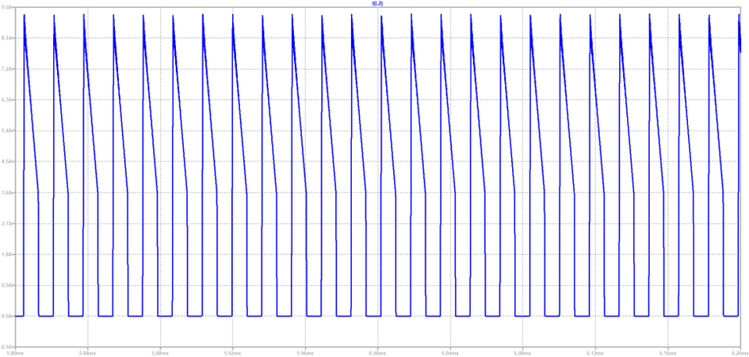
Figure: Secondary Side Current
RMS Current: 4.3A

Slide 9
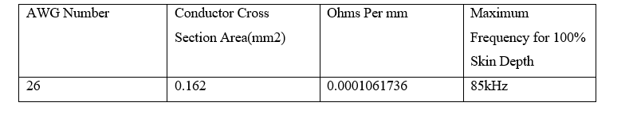

Slide 10
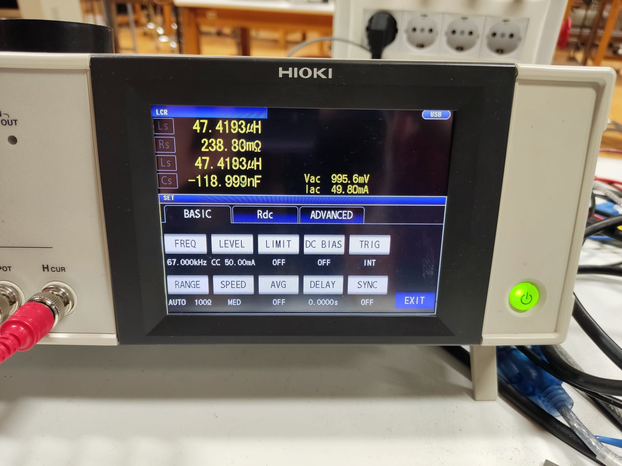
MAGNETIZING INDUCTANCE

Slide 11
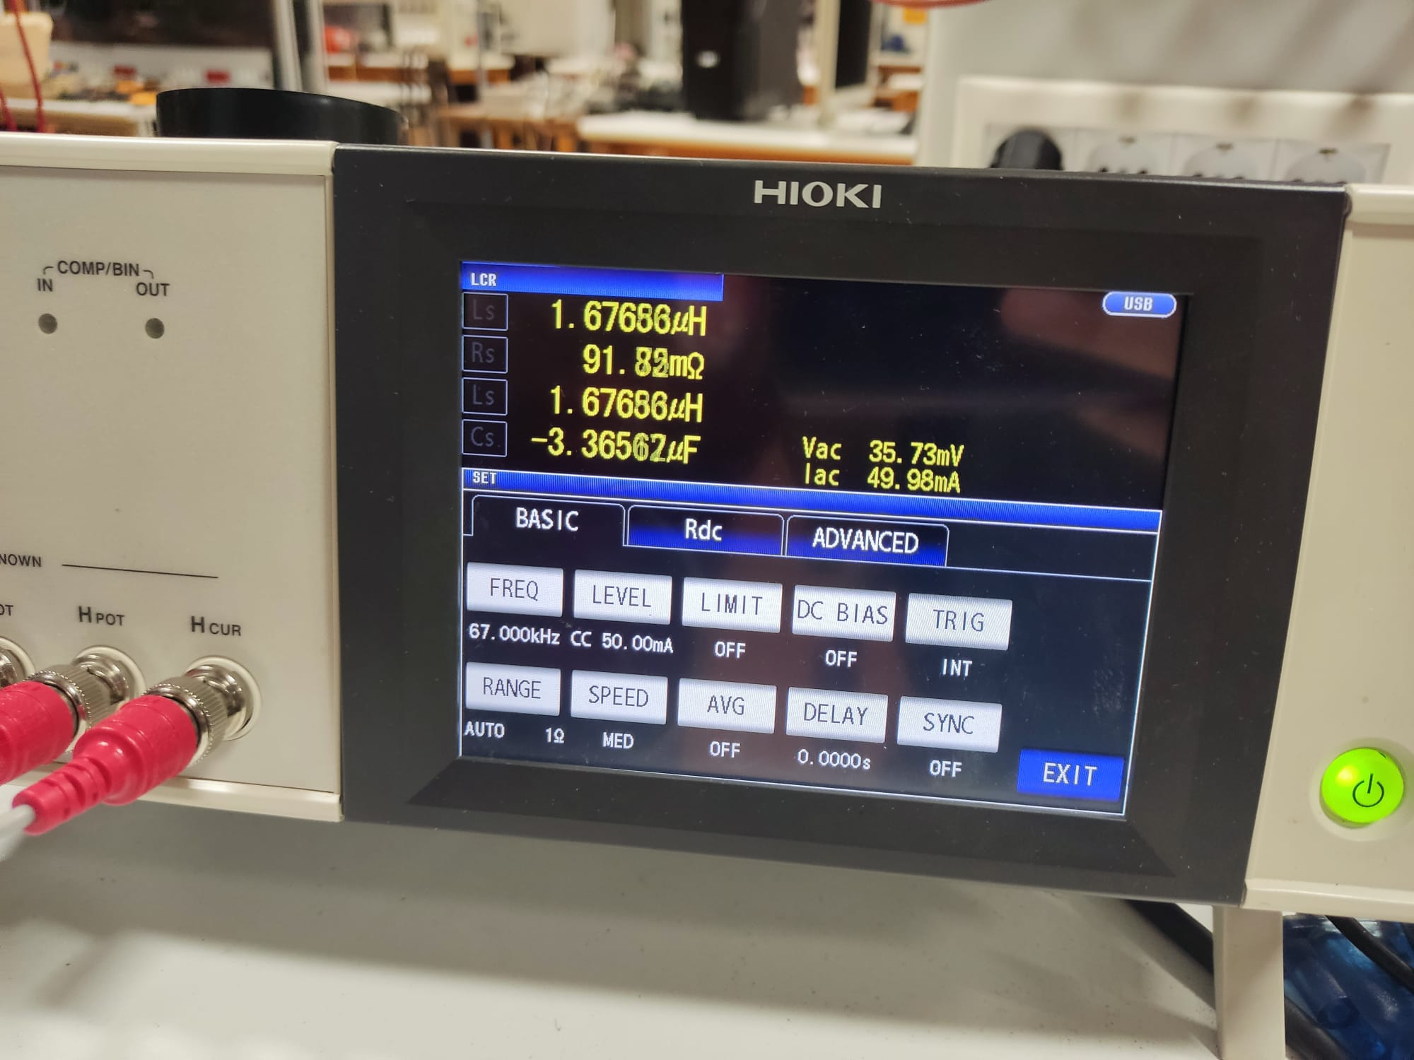
LEAKAGE INDUCTANCE

Slide 12
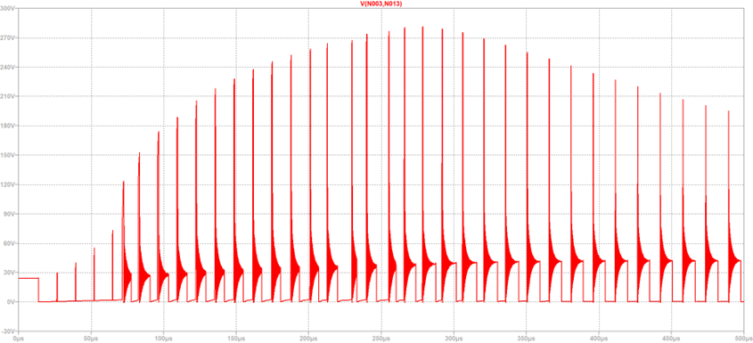
Component Selection
MOSFET Selection
MOSFET Voltage Waveform Transient (24V Input)

Slide 13
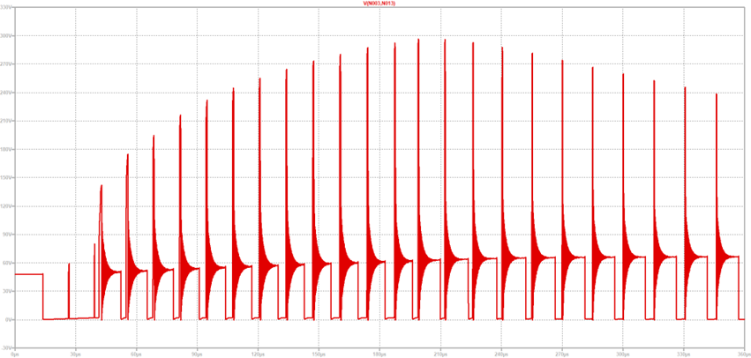
MOSFET Voltage Waveform Transient (48V Input)

Slide 14
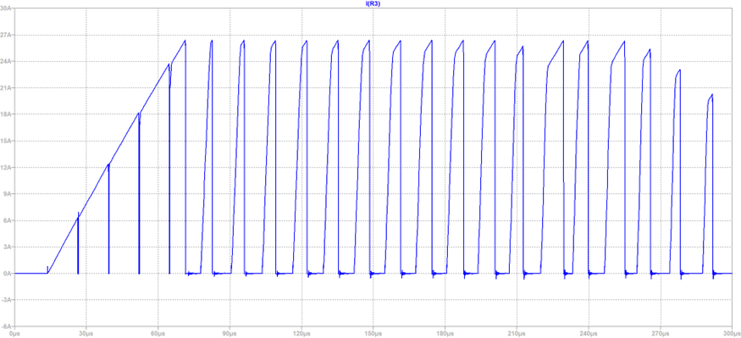
MOSFET Current Waveform Transient (24V Input)

Slide 15
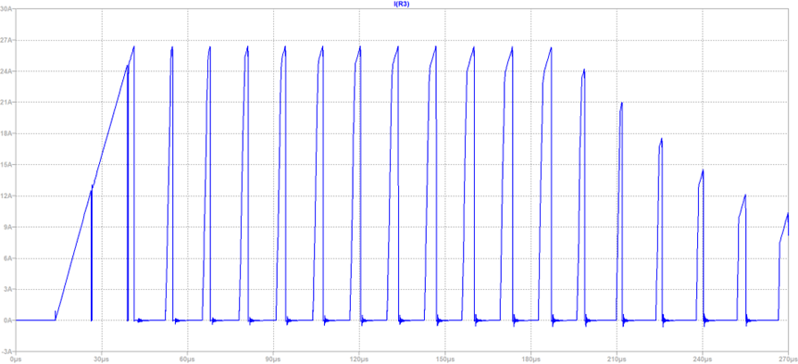
MOSFET Current Waveform Transient (48V Input)

Slide 16
Vin | Peak Voltage | Peak Current
24 V | ~280 V | ~27 A
48 V | ~300 V | ~27 A
IXFP38N30X3M N-Channel MOSFET
300 V
38 A

Slide 17
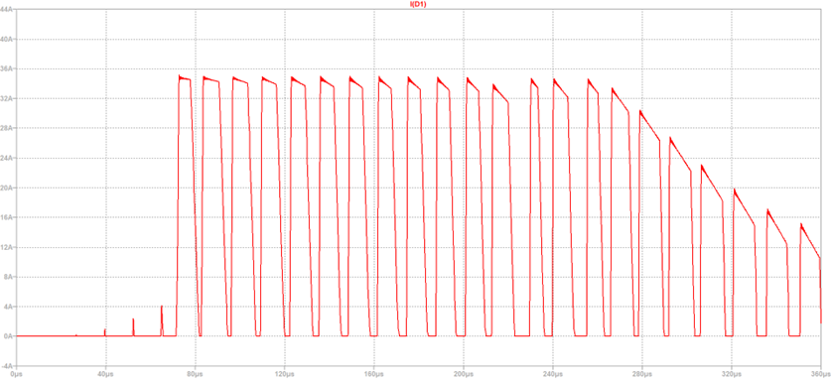
Component Selection
Diode Selection
Diode Current Waveform Transient (24V Input)

Slide 18
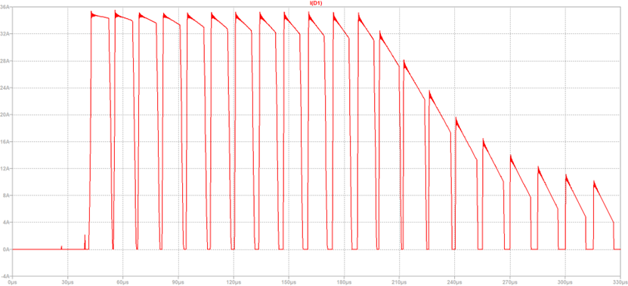
Diode Current Waveform Transient (48V Input)

Slide 19
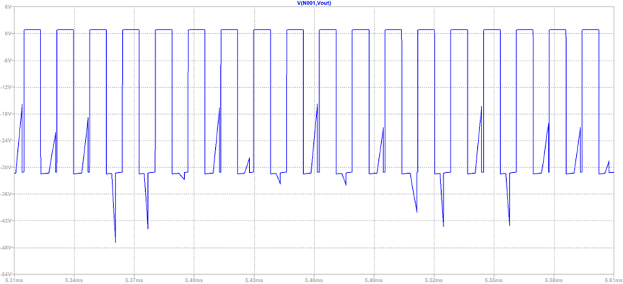
Diode Voltage Waveform Steady State (24V Input)

Slide 20
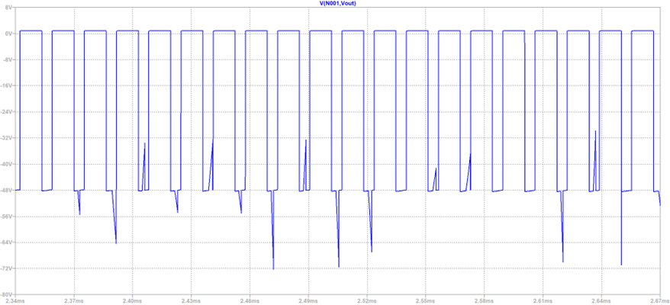
Diode Voltage Waveform Steady State (48V Input)

Slide 21
Vin | Peak Voltage | Peak Current
24 V | ~-48 V | ~35 A
48 V | ~-72 V | ~35 A
ESAF92-03R Diode
300 V
60 A

Slide 22
Component Selection
Capacitor Selection
470uF 25 V electrolytic capacitor is selected.

Slide 23
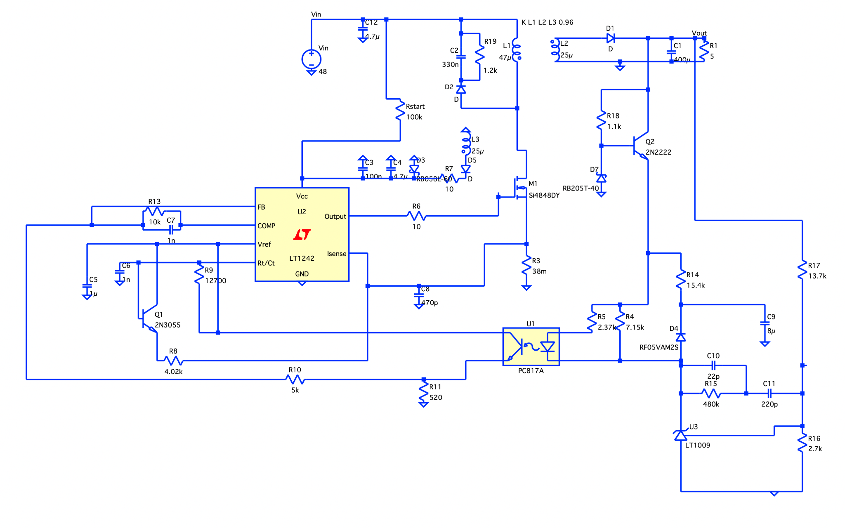
Controller Design

Slide 24
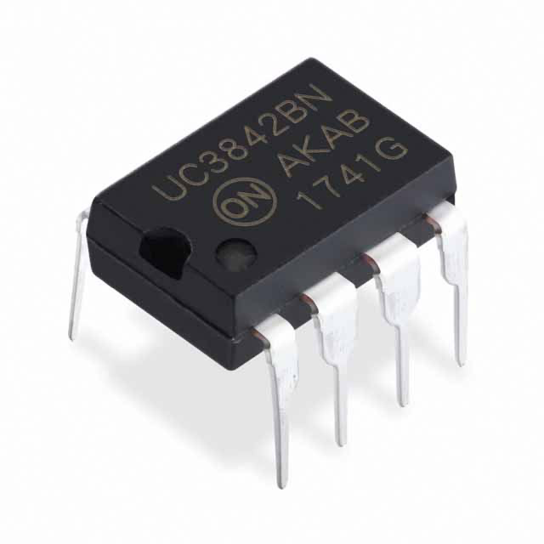
IC Selection : UC3842
Advantages
Can be found in Turkish Market
Very cheap w.r.t other ICs
Voltage can be controlled using a POT
Current Mode Control
A desired frequency can be controlled by changing resistor and capacitor
Can drive MOSFET gate without any additional circuit component
Disadvantages
Requires a third winding in order to feed the input pin.

Slide 25
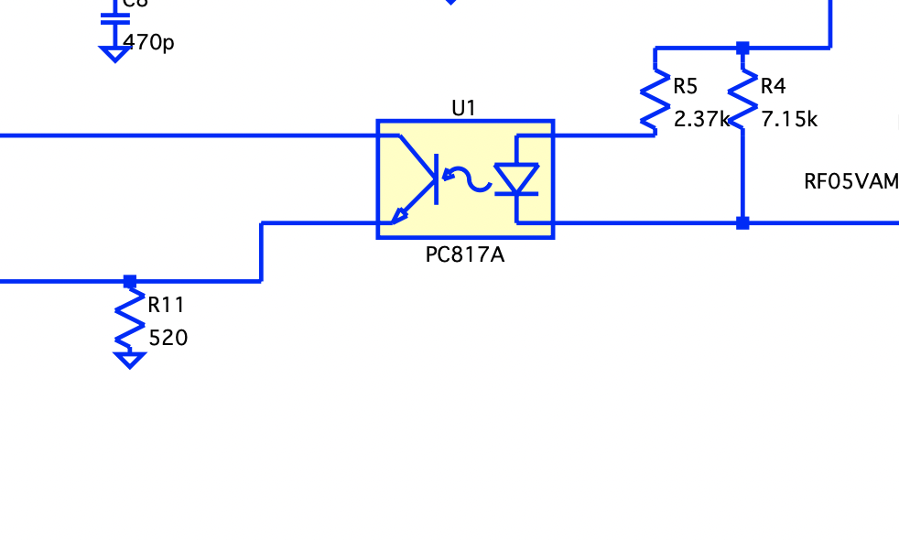
Isolation
In order to obtain physical isolation between primary and secondary side,we need to use an optocoupler.
Output voltage can be controlled used R5 and R11. When we changed this resistors, the sensibility of feedback also changes. It effects the Vref voltage. Finally, the output voltage is determined.

Slide 26
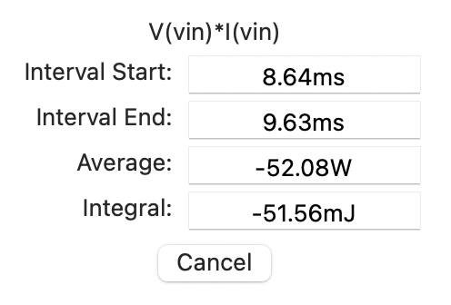
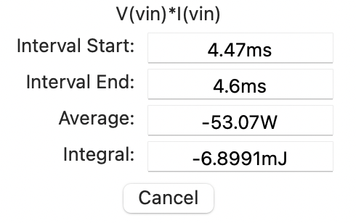
Expected Efficiencies
In the simulation report, we used arbitrary MOSFET and Diodes in order to understand basics of the controller design.
Finally, we have chosen suitable components (diodes, mosfets). Then, efficiency is increased from 80% to 89%.
48 & 24V Input Voltages

